Slide 1
Graduate Projects Meeting December 5, 2025 Project Initiation Steps
Understand the Course Requirements and Procedures
Project Proposal Requirements
Exploring the available Projects
How to add the course

Slide 2
Course Requirements and Procedures
Prerequisites for ME 295 A and ME 299 Course
Completed at lease nine-units in the program
Classified status
Not Conditionally classified
Approved Candidacy form (or expected to be approved before submission of the project proposal)
Not on probation

Slide 3
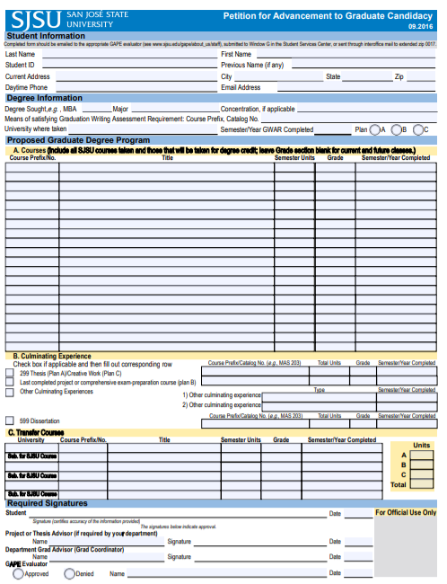
Project Proposal Requirements
1. Have an approved
Candidacy Form
Form is available on
the ME website

Slide 4
Project Proposal Requirements
Candidacy Form
https://www.sjsu.edu/me/docs/forms_gape-candidacy.pdf
Step-by-step Instructions for Filling out the Form
https://www.sjsu.edu/me/docs/msme_currentstudents-candidacy_form_instructions_02_05_19.pdf

Slide 5
Requirements
2. A completed proposal should include:
A. The Project Cover Page
B. Approved committee evaluation
C. Approved Candidacy Form
D. A comprehensive and detailed proposal of the project
NOTE: Submit all the four items in the listed order and as one package
See the ME website for details:
https://www.sjsu.edu/me/graduate/current-msme/advising/project-and-thesis/project-proposal.php

Slide 6
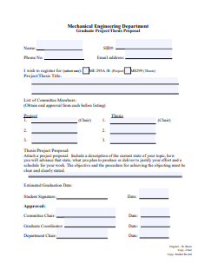
A. Project Cover Page

Slide 7
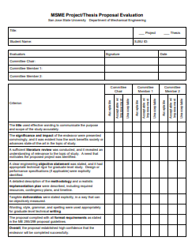
B. Committee Evaluation Form

Slide 8
Step-by-step Instructions for Submitting the Proposal
http://www.sjsu.edu/me/docs/project_thesis_proposal-MSME%20Proposal%20DocuSign%20guide-20230118.pdf
Submit your proposal to the ME office

Slide 9

3. Have the Proposal Ready
A proposal is considered complete when Signed by:
Your committee Chair
The Graduate Advisor
The department Chair

Slide 10
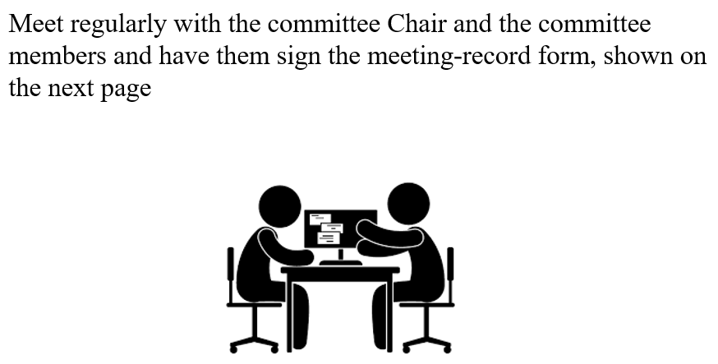
4. Post-Proposal Requirements

Slide 11
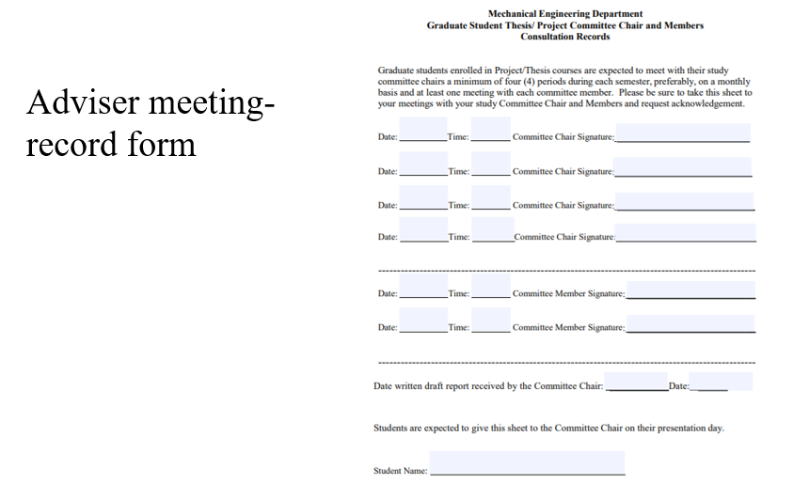

Slide 12
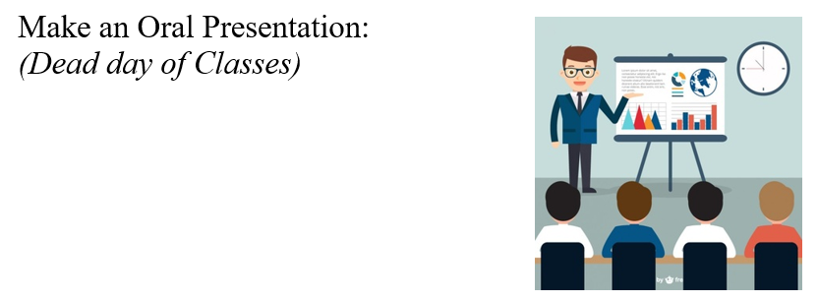
5. Oral Presentation
NOTE: This is scheduled by the ME office

Slide 13
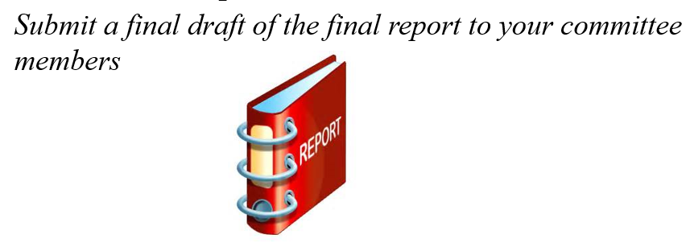
5. Oral Presentation
Before the Oral presentation:

Slide 14
Deliverables
1. Midterm Report: Check with your committee chair
2. Oral Presentation
3. Final Report (draft): Before you make the Oral
presentation
4. Advisory committee consultation form
4. Final Report: For due date, check with your Committee Chair

Slide 15

How to Arrange for the Oral Presentation?
Contact the ME office to schedule your oral presentation. The ME office will contact your advisory committee and schedule your presentation.

Slide 16
How to Add ME 295 A or ME 299
You must have an approved proposal to get an add code.
After the proposal is fully approved, ask your committee chair for an add code for the course
No Pre-registration allowed

Slide 17
Important dates and Deadlines
This Semester:
December 5, 2025
Project Initiation Meeting
December 5, 2025, through December 15, 2025
1. Search for Possible Projects
2. Contact ME Professors and select a Committee Chair
3. Form the advisory committee
4. Conduct a literature search on the project-topic and prepare a draft of the project proposal.

Slide 18
Important dates and Deadlines
Next Semester
January 22, 2026, through February 6, 2026:
Finalize the draft of the project proposal
Have the proposal approved by the advisory committee
Be ready to submit the proposal to the department office
February 9, 2026: Submit the approved proposal to the ME office, for review and approval by the Graduate Advisor and the department Chair
February 17, 2026: University Deadline for adding a course

Slide 19
Note
When your proposal is approved by the ME office, you can obtain the add code from your committee chair.

Slide 20
Available Projects

