Slide 1
New Graduate Students Orientation January 21, 2026
Agenda
Welcome
MSME Program
Q & A
Advising

Slide 2
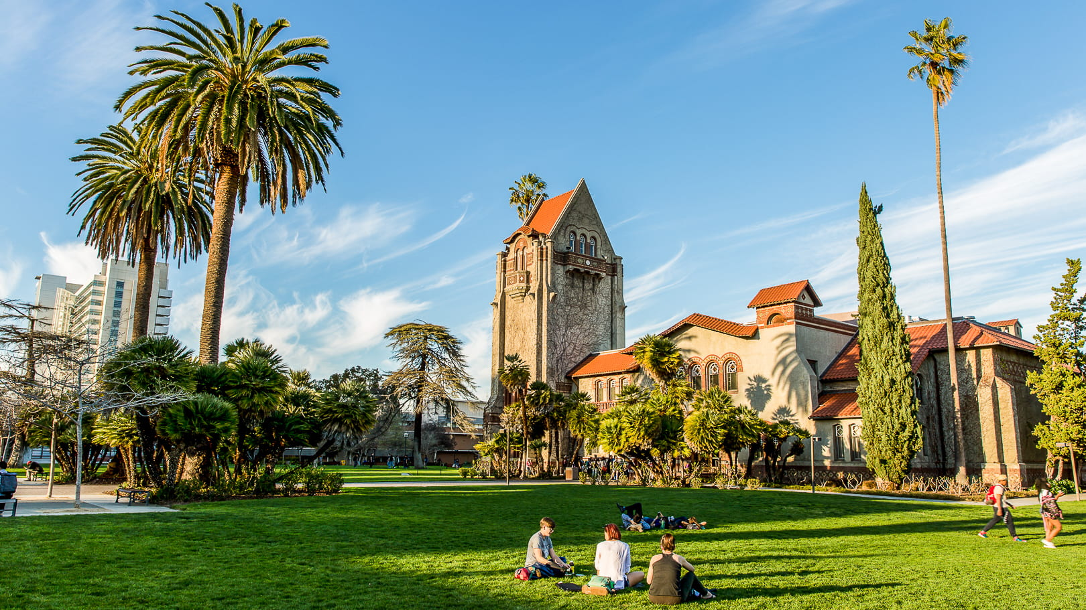
MSME Program
Evening classes

Slide 3
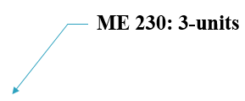
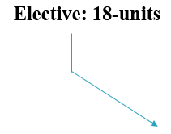
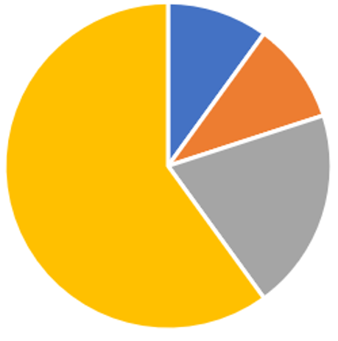


MSME Program
30-units Total

Slide 4
Overall minimum GPA of 3.0 or better
Grade in each of the 30 units for MS degree must be C or better (C- is an F)

Slide 5
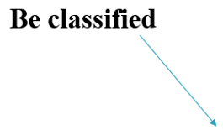



Program Requirements
30-units

Slide 6
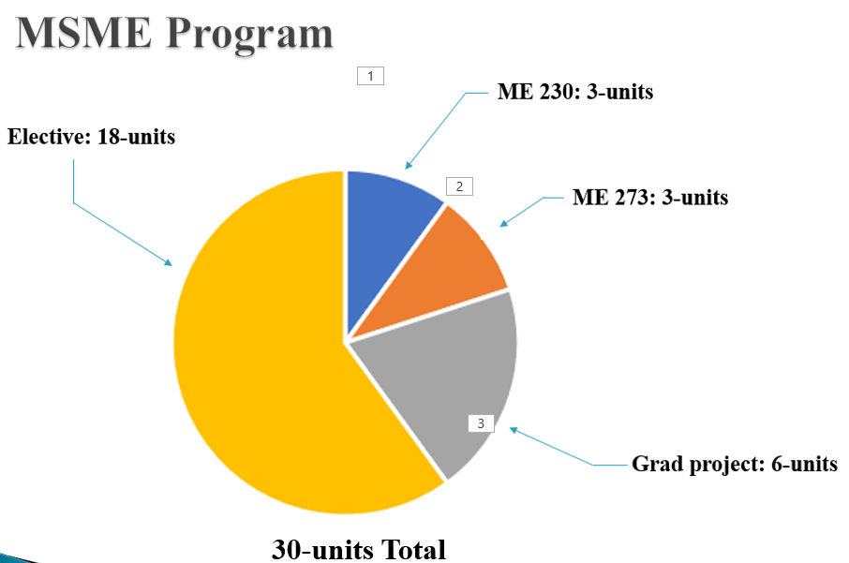






Approved Electives: 18-units
(6-units max)

Slide 7
The list of Approved Undergraduate Electives Courses
ME 135 – Intro to Composite Materials
ME 136 – Design for Manufacturability
ME 160 – Intro to Finite Element Method
ME 165 – Computer Aided Design in ME
ME 170 – Solar Energy Engineering o
ME 171 – Energy Management in Manufacturing
ME 172 – Alternative & Renewable Energy
ME 181 – Fundamentals of Biosensors
ME 183 – HVAC Systems Design
ME 185 – Hybrid and Electric Vehicle Fund.
ME 186 – Automotive Engineering
ME 187 – Automatic Control Systems Design
ME 189 – Design and Manuf. Of Microsystems
ME 192 – Robotics and Manufacturing Sys.

Slide 8
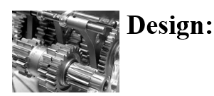
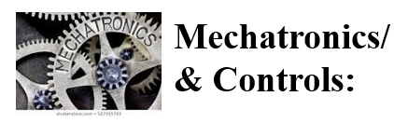
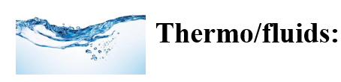
About the Program
Three Areas of emphasis:
  Example:
  ME 240 ME 243, ME 250, ME 256, ME 260, ME 265
  Example: ME 280, ME 281, ME 282, ME 283, ME 284, ME 285
  Example:
  ME 200, ME 210, ME 211, ME 221, ME 271

Slide 9
Course Plan
Here is a two-years graduation plan
  First Semester
  ME 230 3
  ME 273 3
  Elective-1 3
  Total 9
  Second Semester
  ME 291 (elective-2) 3
  (also, an elective)
  Elective-3 3
  Elective-4 3
  Total 9
  Third Semester
  ME 295A 3
  Or
  ME 299-I 3
  Elective-5 3
  Total 6
  Fourth Semester
  ME 295B 3
  or
  ME 299-II 3
  Elective-6 3
  Total 6
  Total 30 Units

Slide 10
Two-Year Graduation Plan (cont.)
NOTE
If you plane to be employed part-time or full-time, adjust the above schedule according to your expected work commitments
To be able to graduate in 4 or 5-semesters, you must take ME 291 during your second semester, otherwise your graduation will be delayed
You can take any Elective course in any order; there are no prerequisites to any of the elective courses

Slide 11
Note Regarding ME 291
This course satisfies the GWAR, and also awards 3-elective units
You must be in a Classified status before you are qualified to take this course:
  a. Have an overall GPA of 3.0 or better
  b. Have a non-conditional status
  c. Not on probation
Pre-registration for this course is not allowed. You can add it only by getting an add code from the instructor

Slide 12
Program Notes
No rigid requirement for electives
You can pick and choose any elective ME Graduate courses
Generally, two courses/semester are offered in each area of emphasis
Up to 6 units of the approved undergraduate elective courses can be taken, which will satisfy the MSME program
Up to 9 units of graduate level coursework can be transferred.

Slide 13




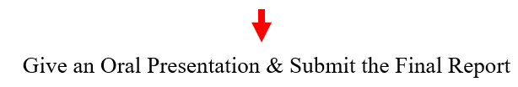

Steps for Graduation

Slide 14
Graduate Writing Assessment Requirement (GWAR)
The Graduate Writing Assessment Requirement (GWAR) is a university requirement
You must satisfy the GWAR before submitting the Candidacy form
GWAR can be satisfied by passing the ME 291 course

Slide 15


Steps for Completing Project/Thesis (6-units)
Complete the Project

Slide 16
About the Oral Presentation (Project/Thesis)
Given at the end of a semester
½ hour Oral Exam at the end of the first term of Project/Thesis
One-hour Oral Exam at the end of the second term of Project/Thesis
A draft copy of the final report is due before the oral Defense and a bound copy is due after the Oral Defense

Slide 17
Advising
  There is no mandatory advising for removing academic hold.
  Contact the ME office if you can’t register for classes
  For any questions related to your MSME program, contact the Graduate Program Advisor
  Advising is required if you are on Probation
  There is no advising available during the semester breaks and holidays

Slide 18
Advising Resources
Advising Resource:
https://www.sjsu.edu/essc/index.php

Slide 19
Registering for Classes
When eligible, you can register most of the courses online, except the graduate project courses and ME 291
If you are unable to register for classes, you can add a class by getting an add code from the instructor (after the classes have started)
Graduate ME classes usually accommodate all
If you are Conditionally Classified and fulfilling a Conditional undergraduate class:
  Get an add code from the instructor (after the semester starts)
  Let the instructor know you are a graduate student and the Graduate Advisor has waived the pre-requisites
  Get written permission from the Graduate Advisor if needed

Slide 20
Registering for Classes
Classes You can’t Pre register
ME 295 A
ME 295 B
ME 299
ME 291

Slide 21
Probation and Disqualification
Probation: Overall GPA < 3.0
Disqualification: GPA < 3.0 two consecutive semesters
Reinstatement

Slide 22
Transfer Credits
Courses taken at other than SJSU Institutions
  Must be equivalent to the current SJSU courses
  Fill out an Equivalency Form and see the corresponding course instructor for evaluation
  Only a maximum of 9-units can be transferred
Courses taken at SJSU
  You can transfer up to 9-units of graduate ME courses completed as an SJSU undergraduate or taken on Open University. No pre-approval is required.

Slide 23
Resources
ME Web site:
https://www.sjsu.edu/me/

Slide 24
QUESTIONS
?

